Slide 1

WEEK 01
Instructor: Yanan Wu
TA: Khadija Nisar
Spring 2025

Slide 2
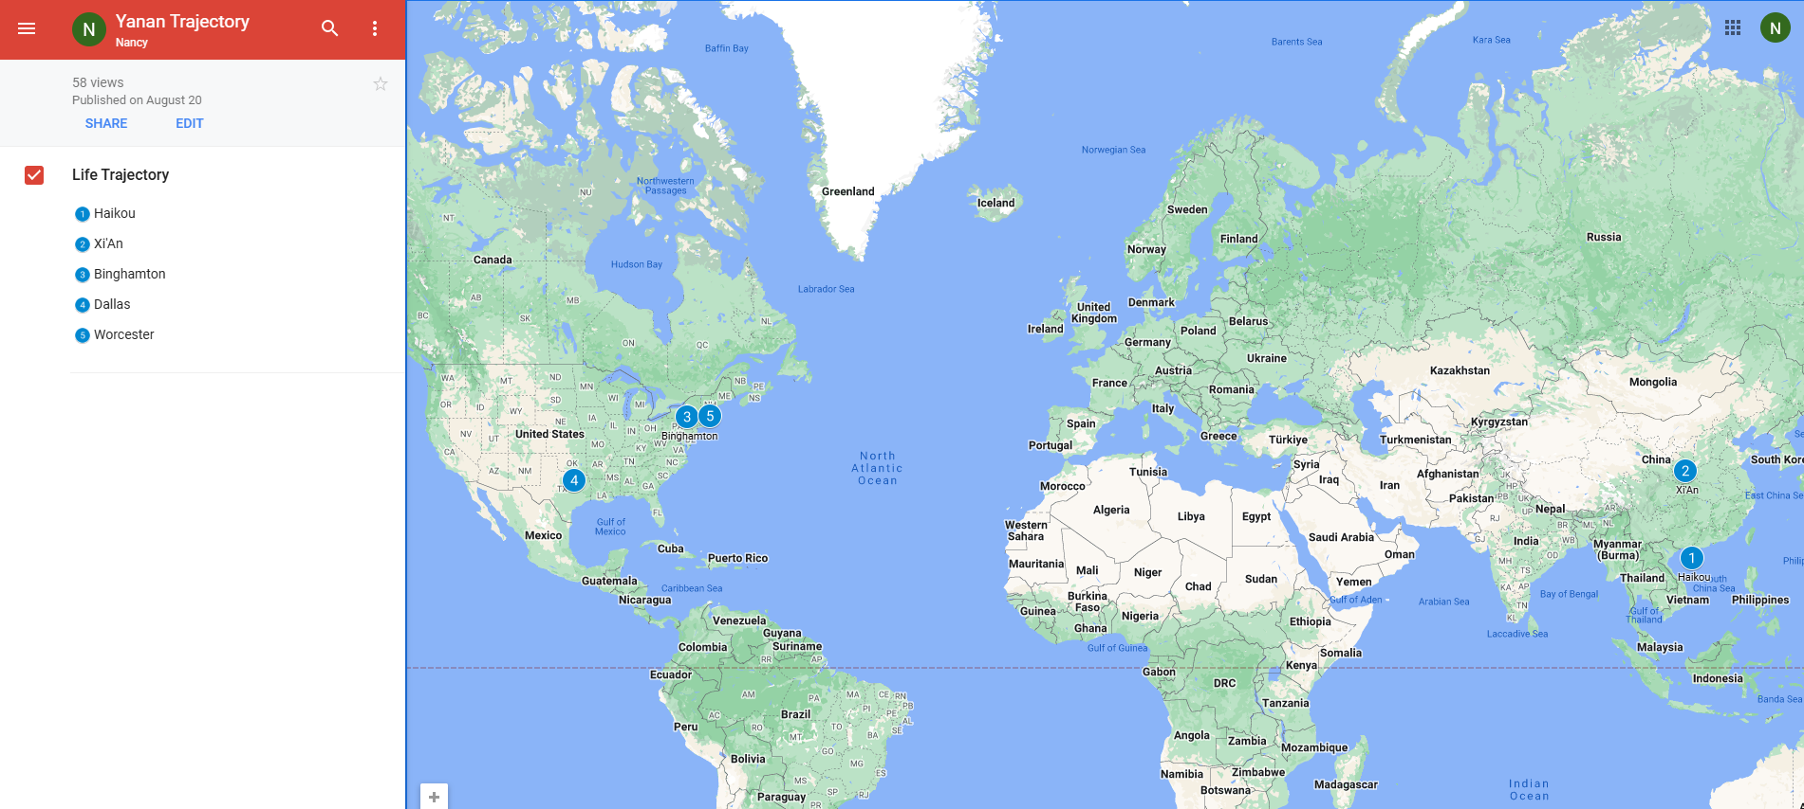
Yanan wu – visiting assistant professor
Education & Experience

Slide 3






Python Programming
Spatial Database
Intermediate Statistics
Manipulating Spatial Data
Web Mapping
Processing Raster
Data Analysis
Creating Custom Tool
Data Visualization
…
Geodatabase
SQL
Proximity Analysis
Geometry processing
Raster processing
PostSQL with python
…
Bivariate regression
Logistics regression
PCA
GWR
Spatial Autocorrelation
…

Slide 4
Instructor office hour
Instructor: Yanan Wu
Email: yanawu@clarku.edu
Office Hours: Tuesday & Thursday 1:30 pm – 2:30 pm or by appointment
Location: Jeff 220

Slide 5
Ta introduction
Office Hours: 3: 00 – 5: 00 PM on Tuesday
Office Location: Room 102 B, Main Geography Building

Slide 6
How about you?
Your background (e.g., name, major, where you come from)
What is your funniest thing that happened during your winter break?
What relevant experience do you have with statistics?
What are your expectations for this course?

Slide 7
Resources
Introductory text is available for free via https://www.openintro.org/book/os/
Intermediate book is Joseph Hair, William Black, Barry Babin and Rolph Anderson. Multivariate Data Analysis. Edition 7 or 8. Upper Saddle River NJ: Prentice Hall.
Amazon.com usually offers used copies for less than $30.
https://www.amazon.com/Multivariate-Analysis-Joseph-Anderson-William/dp/9353501350/ref=pd_cp_14_2/144-5828787-2724822?_encoding=UTF8&pd_rd_i=9353501350&pd_rd_r=397e3554-2af1-476b-8336-5c1018af6453&pd_rd_w=Q3cmn&pd_rd_wg=XzEv7&pf_rd_p=0e5324e1-c848-4872-bbd5-5be6baedf80e&pf_rd_r=FYB3ZG6A42Z1ANQMRH1V&psc=1&refRID=FYB3ZG6A42Z1ANQMRH1V

Slide 8
Course requirements
Assignments: 9 in total
For any graded assignment, if the you do not agree with the grade received, the instructor and TA must be notified within one week after the assignment is graded.
Late policy for lab
One final project (oral presentation and paper report)

Slide 9
evaluation
Assignments 80% = nine assignments
Each assignment need to be completed using R
You can ask for help with assignments from the instructor and TA, No plagiarism is allowed
Final Project 20% = 15% oral + 5% written
To apply & to interpret statistical procedures
To make an oral presentation of a statistical analysis
To write a report
A | 93.0 - 100.0 | B+ | 88.0 - 89.9 | C+ | 77.0 - 79.9 | D+ | 67.0 - 69.9
 |  | B | 83.0 - 87.9 | C | 73.0 - 76.9 | D | 60.0 - 66.9
A- | 90.0 - 92.9 | B- | 80.0 - 82.9 | C- | 70.0 - 72.9 | F | 0.0 - 59.9

Slide 10
Important dates
Jan 22. Add/Drop ends (& last day to request audit) Full Semester
No class
Jan 20. University holiday
Feb 17. Wellness day
March 3-7 Spring Break
March 24-27 AAG Conference
Final project
April 14-24 Working on final project
April 28 – May 1 Final project presentation
May 5 Final report due

Slide 11




COURSE WEBSITEs ON GITHUB
Intermediate Statistics
Spatial Database
Python Programming
Web Mapping

Slide 12

GIS HELP DESK
NEW SPRING 2025 HOURS:
Need help with GIS? Can't make it to visit your professor or TA for office hours? Stop by our GIS Help Desk in the Jefferson Tower (6th floor), or in Jefferson 220A (2nd floor Jefferson building, Geog Main office) on Wednesdays, and visit one of our Help Desk Assistants!
MONDAYS
TUESDAYS
WEDNESDAYS @ JF220A
THURSDAYS
FRIDAYS
SASHA 9 AM - 11 AM
SASHA 9 AM - 12 PM
SASHA 9 AM - 12 PM
WYNNIE 2 PM - 5 PM
WYNNIE 2 PM - 5 PM
WYNNIE 3 PM - 5 PM
GIS Help Desk hours follow a University schedule. If the University is closed from remote/online operations for any reason, the GIS Help Desk may also be unavailable. GIS Help Desk Assistants operate on a first-come, first-serve drop-in basis. Contact Marjorie Miller (marmiller@clarku.edu) with any questions, or call the Geography Main Office at 508-793-7336 for more information. The GIS Help Desk is sponsored by the Graduate School of Geography at Clark University.

Slide 13
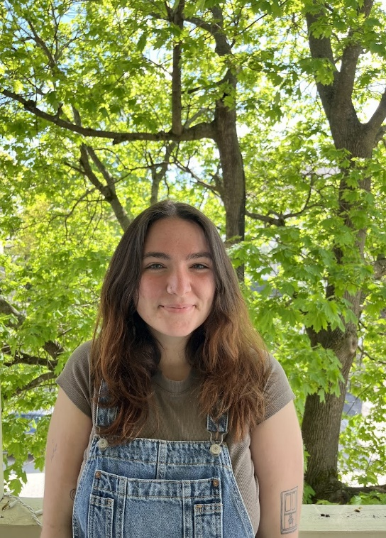

Spring 2025 hours
GIS Help Desk
Please contact either of our GIS Help Desk Assistants during their specified hours for more information.
SASHA GANNON| GEOG ’24 MS-GIS ‘25
WYNNIE GROSS| GEOG ’24 MS-GIS ‘25
MONDAYS 9AM – 11AM
TUESDAYS 9AM – 12PM WEDNESDAYS* 9AM –12PM
WEDNESDAYS*
3PM – 5PM
THURSDAYS
2PM – 5PM
FRIDAYS
3PM – 5PM
Help Desk hours follow a University schedule. If the University is closed (or if the Geography office is closed), the GIS Help Desk will be unavailable. Hours may be limited or extended during midterms/final exams. Any changes will be announced or posted on the Clark University Geography Facebook page. Appointments operate on a first-come, first-serve drop-in basis unless otherwise scheduled.
508.793.7336 | Jefferson Tower, 6th Floor; *Wednesdays are in Jefferson 220A, Geog Main Office, Jefferson Building, 2nd Floor*

Slide 14
WEEK 01 weekly schedule
Instructor: Yanan Wu
TA: Khadija Nisar
Spring 2025

Slide 15
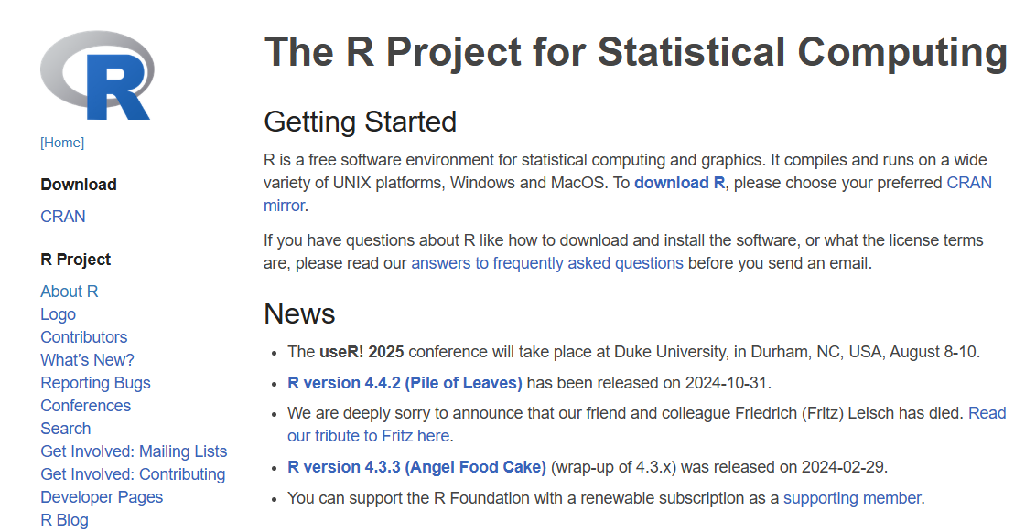

Course introduction software installation
Week 01
R programming
R-Studio
Open-source IDE (integrated development environment)

Slide 16
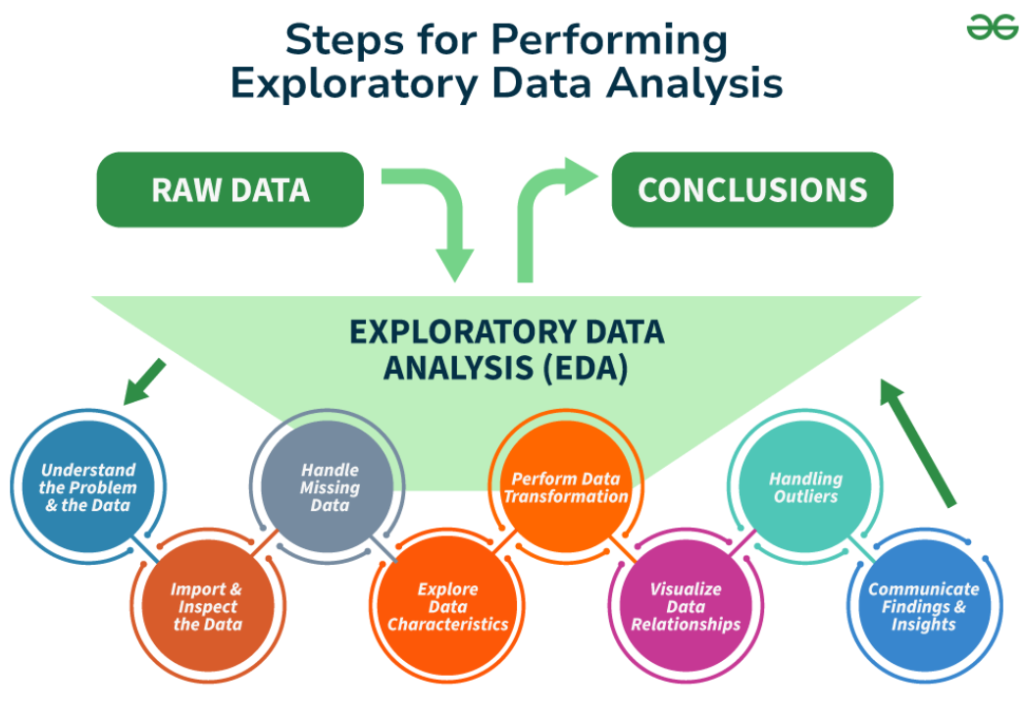
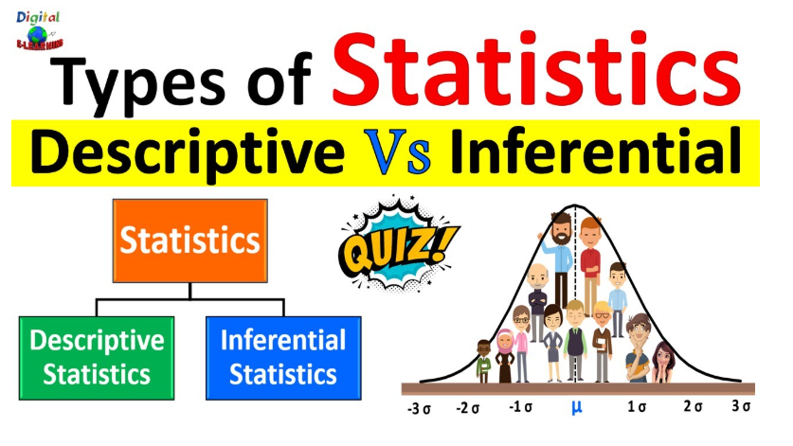
Week 02&3
Week 02 & 03
Inferential statistics
Data Exploration

Slide 17
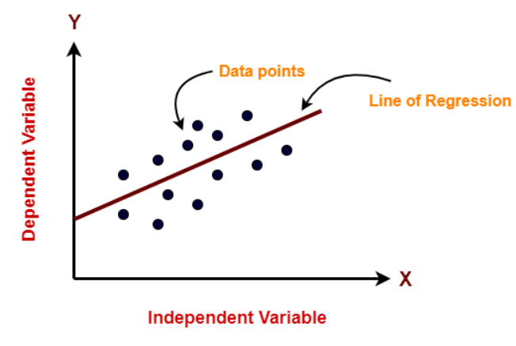
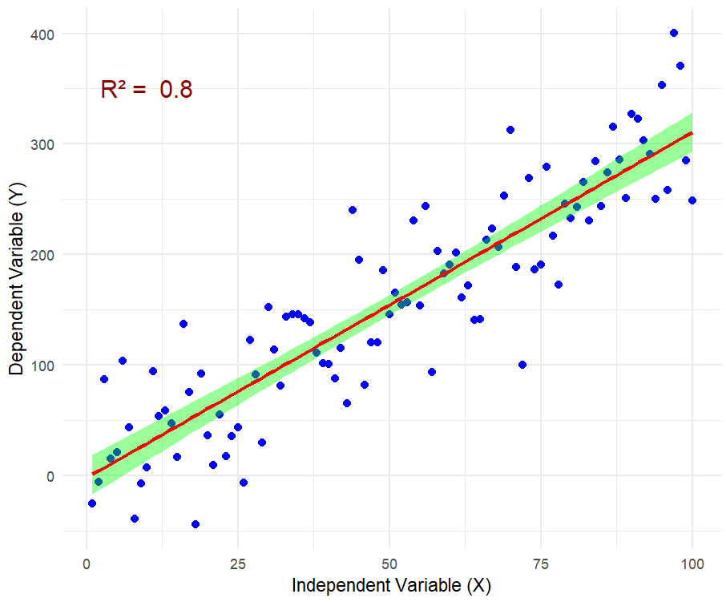
Week 04
Bivariate Regression
Key Assumption
Slope and Intercept
R square
Confidence Interval

Slide 18
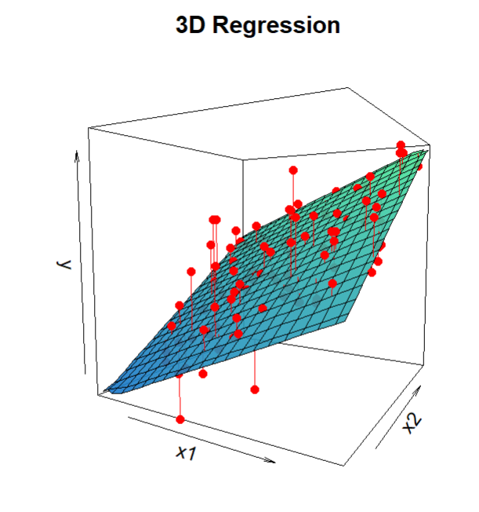
Week 05 & 06
Multiple Regression

Slide 19
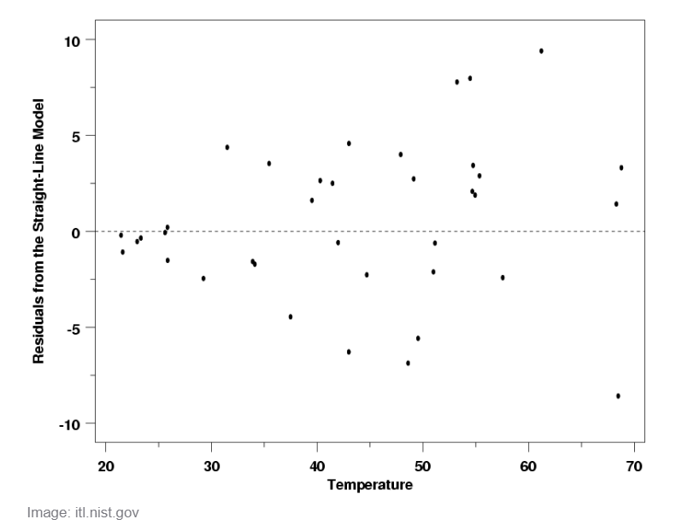
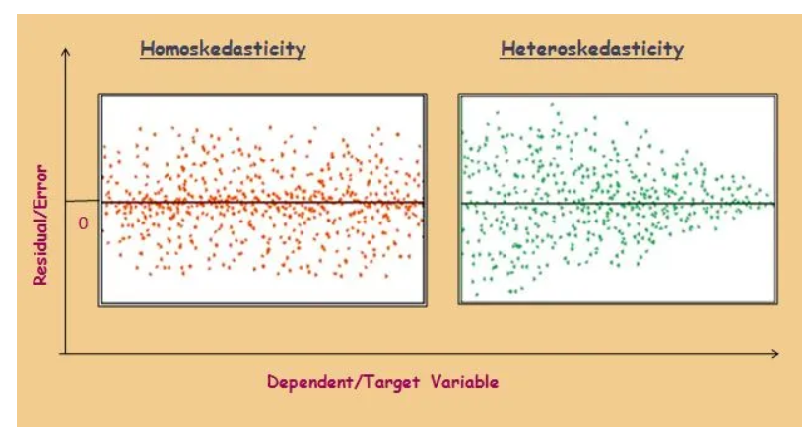
Week 07
Regression Criticism

Slide 20

Week 08
Happy Spring Break!

Slide 21
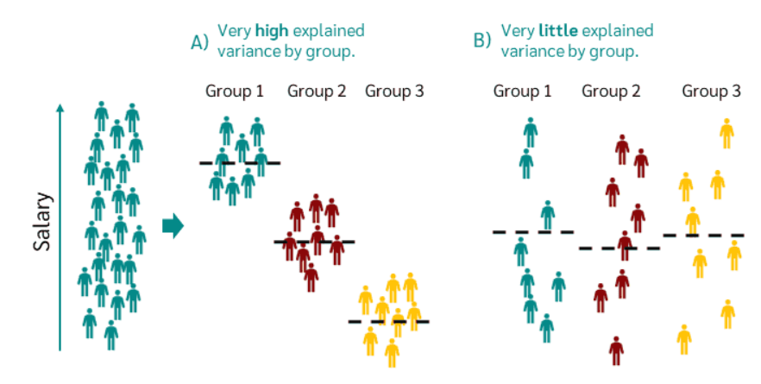
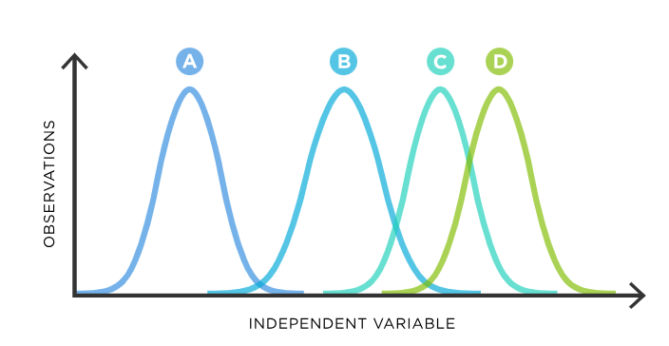
Week 09 anova
Assumption of ANOVA
Type of ANOVA
Diagnostic in ANOVA

Slide 22
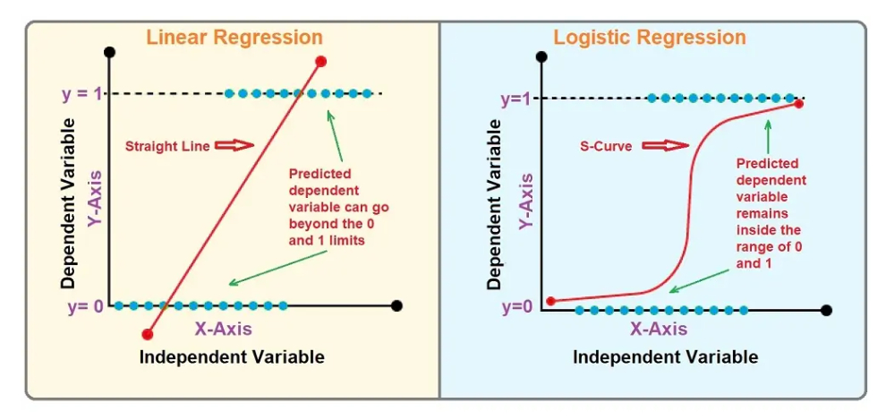
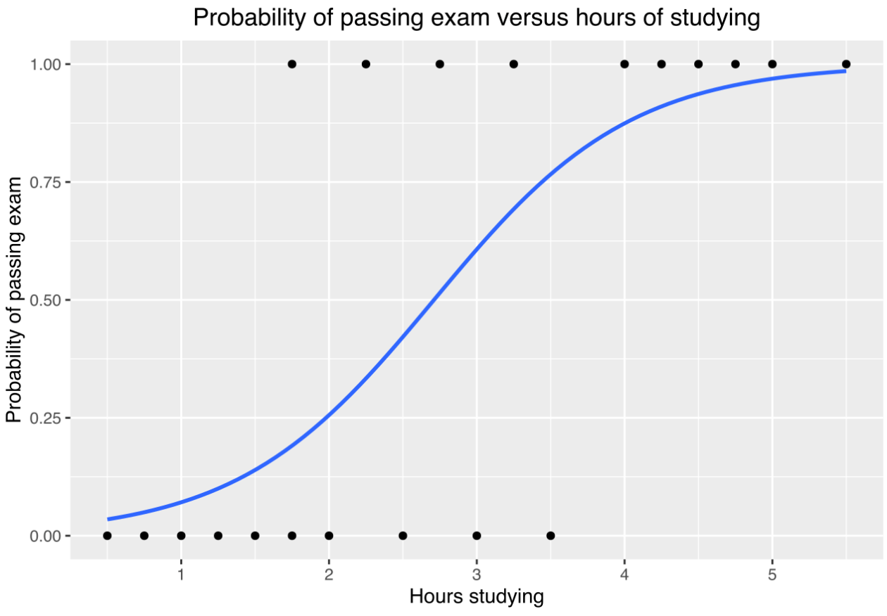
WEEK 10
LOGISTIC REGRESSION

Slide 23

WEEK 11
2025 AAG Conference

Slide 24
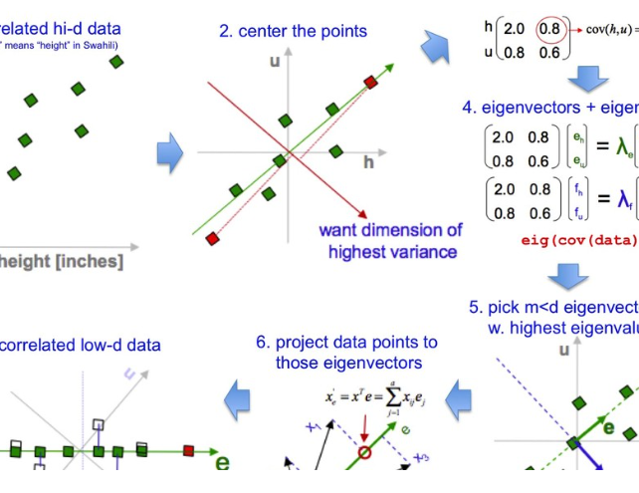
week12
Principal Component Analysis
A powerful dimensionality reduction technique used in statistics and machine learning to simplify complex datasets.

Slide 25
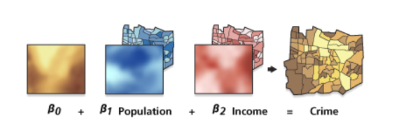
WEEK 13
geographically weighted regression

Slide 26
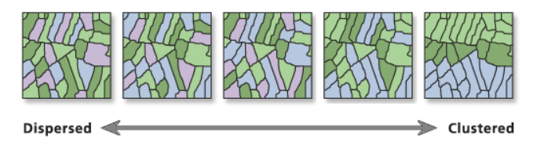
Week 14
Spatial Autocorrelation

Slide 27
Preamble
A good online textbook, Hands-on Programming with R, for R beginner.
Explore the R project website: https://www.r-project.org/
Explore R Studio: https://posit.co/

Slide 28
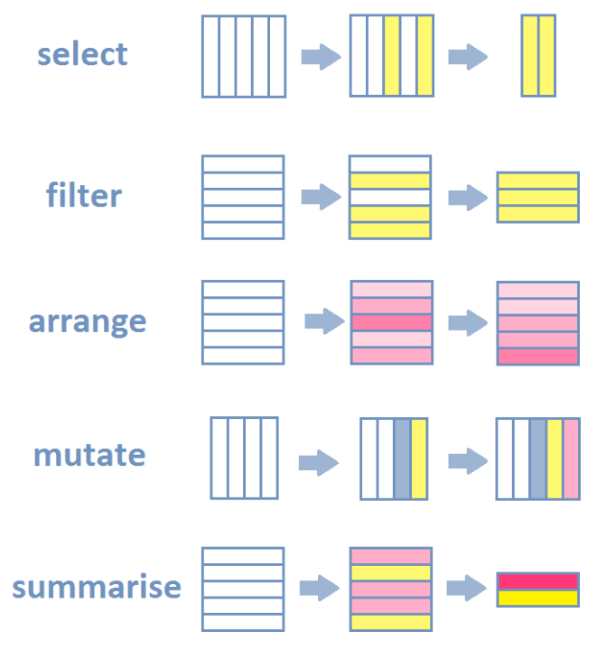
R-INTRODUCTION
An online free learning source: An Introduction to R
Data Manipulation
Data Visualization
Data Visualization Section in R for Data Science
Modern Data Visualization with R
Interactive Applications
Shiny Gallery in R

Slide 29
R - Introduction
Statistical Analysis
Geospatial Data Analysis
Descriptive analysis (mean, median., etc)
Regression analyses (linear, logistic, ect)
Time series analysis (ARIMA, etc)
Multivariate analysis (PCA, factor analysis)
A handbook of statistical analysis in R
Handle raster and vector data
Analyze spatial data with sf, sp or raster

Slide 30
R - Introduction
Machine Learning
Implement supervised learning (classification, regression).
Apply unsupervised learning (clustering, dimensionality reduction).
Perform deep learning with packages like keras or torch.
Evaluate models using cross-validation and other metrics.

Slide 31
WEEK 01 lab session
Instructor: Yanan Wu
TA: Khadija Nisar
Spring 2025

Slide 32
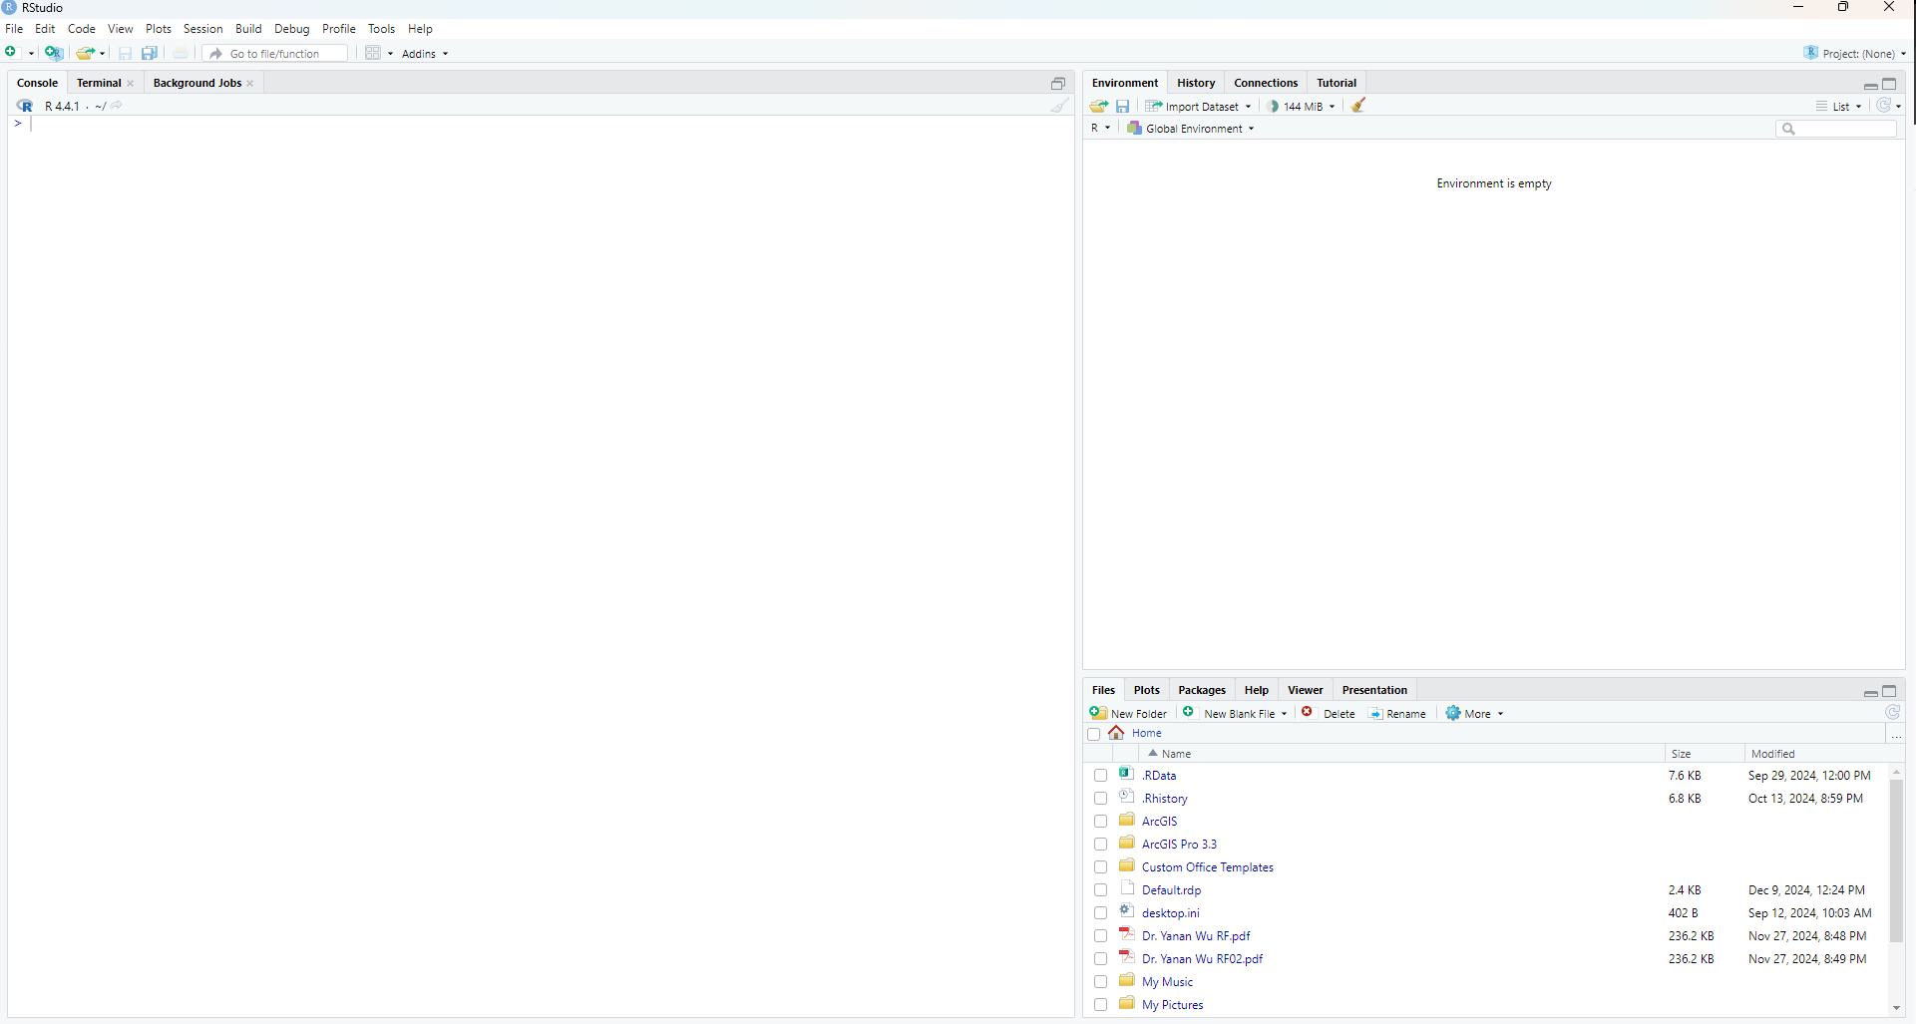
Overview of RSTUDIO INTERFACE
The panes
Left pane: R console
Right top pane: includes tabs such as Environment and History
Right bottom pane: File, Plots, Packages, Help and Viewer

Slide 33
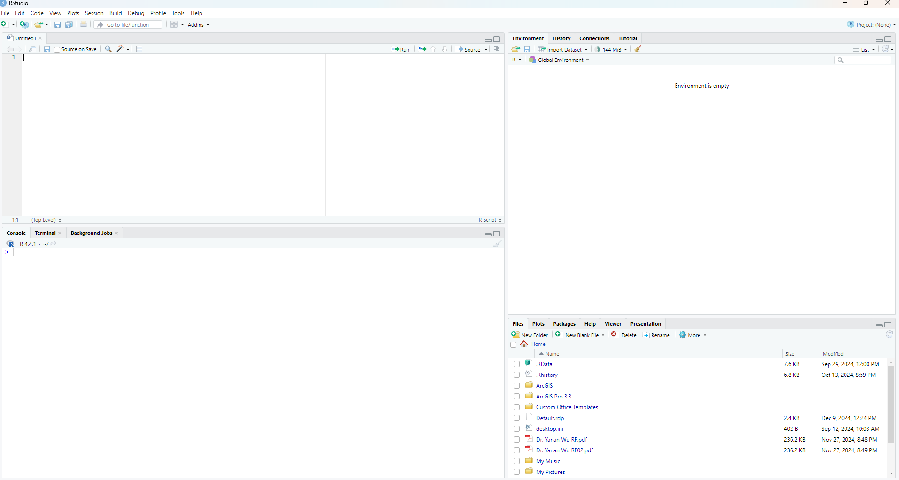
Overview of RSTUDIO INTERFACE
Starts a new pane on the left
File – New File – R Script

Slide 34
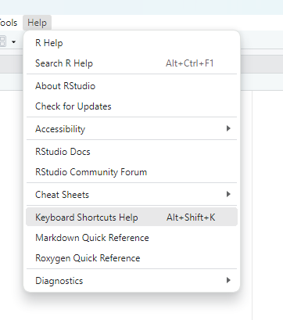
Overview of keyboard shortcuts
Keyboard shortcuts
Help – Keyboard Shortcuts Help

Slide 35
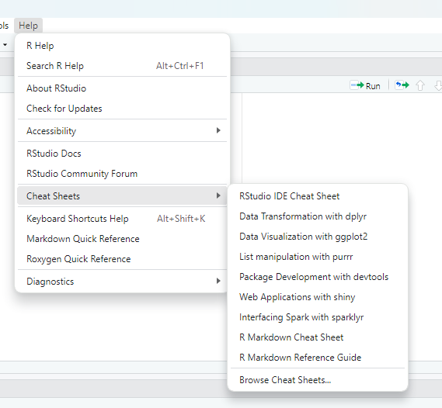
Overview of Cheatsheets
Cheatsheets in Rstudio
Help - Cheatsheets

Slide 36
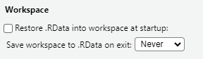
Global setting
.RData
Save your workspace, including variables, data frames, lists, and other objects
Cons
Causing confusions especially when we share code with others and assume they have this .Rdata file
Tools – Global Options
Change the setting as below

Slide 37
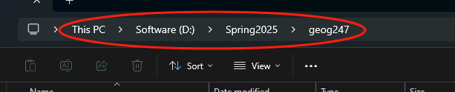
Working directory
Get working directory where your scripts and workspaces are stored
getwd()
Run this command:
Ctrl + Enter
Or Run in R
The returning strings, e.g.,"C:/Users/yy00021/Documents“ is the path to the working directory
The windows convention uses slash \ to separate sub-directories
However, R uses forward slash / or a double backward slash \\
Change working directory
I suggest you to setup a specific directory for this course
setwd('D:\\Spring2025\\geog247’)
Now check your working directory again

Slide 38
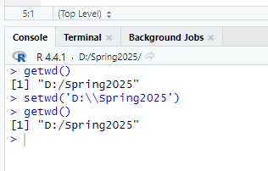
Console window
The character > in CONSOLE window indicates that R is ready to receive new commands
It show up when R completed executing a script

Slide 39

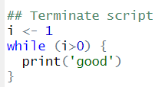
Terminate script
The Esc Key or pressing in the CONSOLE window to terminate the script

Slide 40
Get help
Get help for activate libraries
help('dplyr’)
?dplyr
Get help for all installed libraries
??dplyr
help.search('dplyr’)

Slide 41
Interacting with the R-CONSOLE
All commands (or programs) can be stored in external *.R script-files
Single command or a set of highlighted commands can be run using shortcut (shift+enter) or Run button in R
All commands can be run use the Source button in R
Scroll through the history of previously commands in R
Using shortcut key (Ctrl + L ) or broom icon to clean the Console window

Slide 42
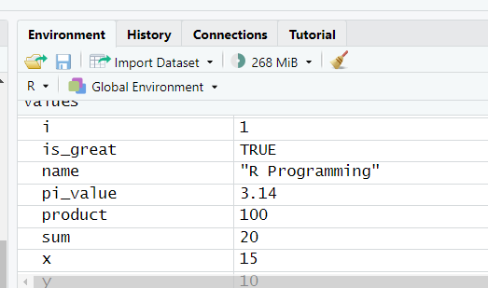
Variables in r
Variable names
Variables are created using the assignment operator <
Variables can store different types of data (numeric, character, logical, etc.).
Variables can be reassigned new values anytime.
The document shows professional naming for your code
Object in the ENVIRONMENT
Any data structure or function that is defined using commands becomes an object in the ENVIRONMENT

Slide 43
Remove objects
The objects can be removed from the ENVIRONMENT
rm(x)
Clean ENVIRONMENT
Broom icon in the ENVIRONMENT mean bar
or rm(list=ls())

Slide 44
LIST IN R
Creating a list
A list in R is a flexible data structure that can contain elements of different types: numbers, characters, vectors, matrices, data frames, or even other lists.
It's like a container for multiple objects.
Accessing elements in a list
Use [[ ]] to access elements by position or name.
Use $ to access elements by name.

Slide 45
Data sets
Read csv
read.csv() for reading CSV files.
Check columns
Accessing column names using colnames()
Add new columns
Adding columns based on calculations or conditions

Slide 46
WEEK 01 PRACTICES
Instructor: Yanan Wu
TA: Khadija Nisar
Spring 2025

Slide 47
practices
Explore Tools and Help in RStudio
Explore the different tables in RStudio

